Slide 1
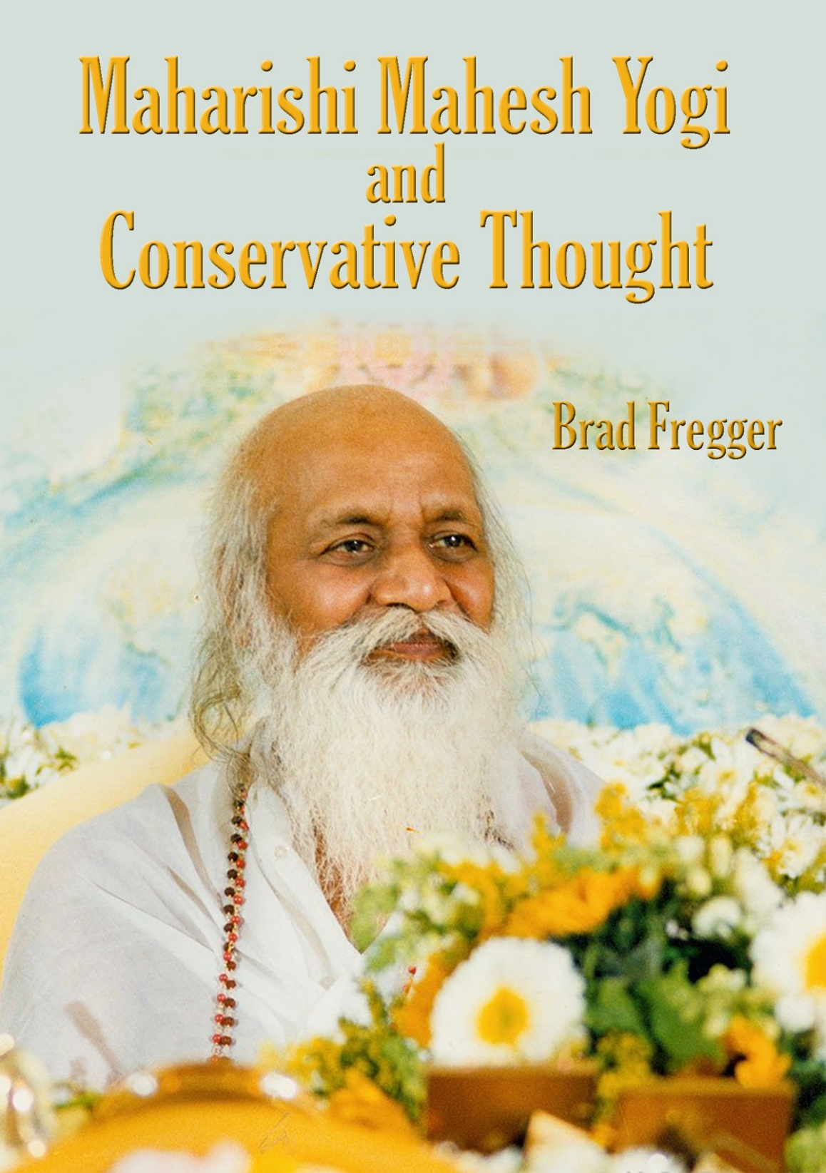
Copyright 2020. Brad Fregger

Slide 2
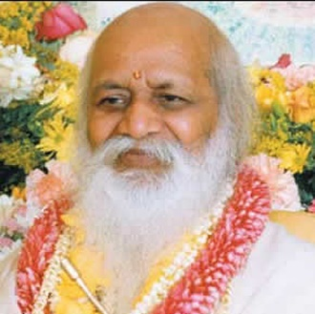
“When an elephant walks through the village all the dogs come out and bark.”
Maharishi Mahesh Yogi
There is no doubt, in my mind, that Maharishi Mahesh Yogi is a Conservative. His teachings scream Conservative Thought. However, while he was teaching his style of Conservatism, the majority of his followers are now being seduced by Progressive Beliefs. Not only people I know, but others here at MIU and famous people like Ellen DeGeneres, Jim Carrey, and Oprah Winfrey are also seemingly confused about Conservative Thought.
This doesn’t make sense to me; the practice of TM was designed to bring bliss and wisdom, and in so doing bring happiness and peace to the world. Progressive Beliefs are the antithesis to Maharishi’s teachings, which I believe, are essentially Conservative. How can they listen to Maharishi’s lectures and, yet, be seduced by Progressivism?

Slide 3
Introduction
They have accepted the lies Progressives tell about Conservatives. They have been frightened by the horror Progressives paint and are unable to see through to the reality.
I now know why I have been called to Fairfield and MIU. I am here to share my truth about Conservative Thought, Progressive Beliefs, and Maharishi’s teachings.
In addition, the followers of TM need to understand why the Progressive Movement will ultimately destroy the TM Movement, if they win.
I’ve had seven careers in retailing, consumer software, publishing, and education. I’ve been an international speaker on leadership and negotiation.
My extended family includes: Caucasians, Blacks, American Indians, Christians, Jews, Hindus, Muslims, Gays, Transgenders, Democrats, Republicans, Conservatives, Liberals, Pro-life, Pro-Choice, Warmists, and Climate Realists. I’ve been a lifelong Conservative and Climate Realist.

Slide 4
Introduction
I have a Master’s degree in Futuristics (Societal Futures) from San Jose State University.
I’m taking a big risk with this presentation. Those who support the Progressive Movement are allergic to any opposing view and will do anything to silence those who dare to suggest that there might be another, more viable alternative.
My wife and two close friends have all felt the ire of friends and associates who, through ignorance, fully support the Progressive agenda and believe that all Conservatives are either ignorant or evil.
Barbara lost one of her close friends years ago when her “friend” discovered she was a Conservative.

Slide 5
A close woman friend lost her two best friends, a gay man and a lesbian woman, when they found out she was a Conservative. How ironic that she, a Conservative, easily accepted their lifestyles and they, Liberals, refused to accept her Conservative philosophy.
Another close friend lost his job when the staff discovered that he had voted Republican in the last presidential election; they demanded that this “immigrant-hating nationalist” be fired. He is actually a wonderful person, an immigrant, and someone who has helped hundreds of poverty-stricken school children on the road to a successful life.
I’ve never known a Conservative who turned his back on a Liberal or Progressive friend, but I have seen the opposite happen multiple times, some instances much more egregious than the ones I’m comfortable mentioning.
In this presentation I will explain Conservative Thought, Progressive Beliefs, and how Maharishi’s teachings relate.
My understanding regarding these issues comes from years of study regarding societal futures and the forces that drive both positive and negative outcomes, especially current socioeconomic health.

Slide 6
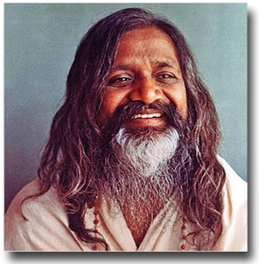
Conservative Thought
"Do not base your life on the likings and dislikings or whims of others. What you are in life - whether you enjoy or suffer - it is your own responsibility.”
Maharishi Mahesh Yogi
Below are the basic tenants of Conservatism. You should understand that Conservative Thought is not monolithic; there are many flavors. However, what I have stated below is truly the heart and soul of Conservative Thought.
Every person of every race, religion, gender, and sexual orientation deserves their chance at happiness; the pursuit of happiness is a God-given right.
Everyone should have the opportunity to reach their potential and, thereby, experience a level of success, personal and financial, that matches their dreams, hopes, and expectations.

Slide 7
Conservative Thought
Everyone should be treated equally in life, career, and education; everyone should be treated with respect, until such time they prove they are unworthy of respect.
No one should receive special treatment under the law; Lady Justice wears a blindfold for a reason.*
Our laws must be followed. Bad or worthless laws should be changed, but until those laws are changed, those breaking them out of ignorance or in protest must accept the penalty for their actions.
With the “God-given rights” clearly stated by our founders come significant responsibilities, the major one being to respect one another and to call out those who take advantage of the weak and ignorant.
* This is why the judges’ chairs are turned on The Voice.

Slide 8
Conservative Thought
The presumption of innocence is critical to the survival of a Democratic Republic. Without it the good fear unwarranted attacks, leaving evil to take over the country.
An all-powerful federal government (even worse, world government) will inevitably take away freedom and liberty from the people, drastically limiting opportunities for individuals to achieve happiness and success.
The vast majority of people know what’s best for themselves and their families and no government, especially a federal government, can make better decisions for them.
The Constitution and Bill of Rights state clearly our personal rights and responsibilities. We must protect what our founders created from all enemies, both foreign and domestic.

Slide 9
Conservative Thought
When people do find themselves in need of help, the best help comes from their community. When the federal government steps in and tries to help, they take power and influence from the community and often exacerbate the problem.*
Every human life is precious. Killing a human, whether in the womb or walking down the street, is murder, a truly evil deed.
Conservatives are committed to the truth, even when it hurts, even when it questions one of their cherished beliefs.
Doing what is right trumps any material or psychological gain.
Understanding must be gained before any problem can be solved, any conflict can be resolved, and an effective decision can be made.
* This reminds me of the nine most terrifying words in the English language, “I’m from the government and I’m here to help.”

Slide 10
Conservative Thought
Conservatives believe that Capitalism* has brought more of the world’s people out of starvation and suffering than any other economic system in the history of the world. Our Democratic Republic plus Capitalism has been a beacon leading to more peace and equality in the world than ever before in history.
It is natural that some have more than others; there will always be different talents, different objectives, and different levels of commitment.
There is a Universal Consciousness who created the entire Universe and everything in it. Some call it God, or Allah, or the Creative Intelligence. These are but a few of the many names of God.
* Not crony capitalism

Slide 11
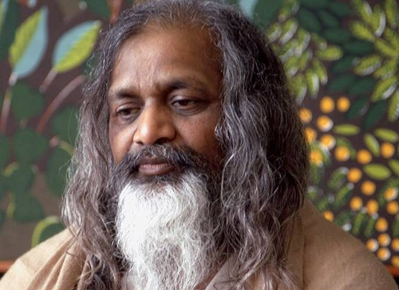
Maharishi’s Teaching & Progressive Beliefs
"It is the responsibility of the older generation to advise the young, to tell the child what is right and wrong. Even if they do not want to listen or follow our direction, it is right to tell them."
Maharishi Mahesh Yogi
In the pages that follow, I will compare the previous Conservative statements to what Maharishi has taught and what Progressives believe.
I will comment at times for clarity.

Slide 12
Maharishi’s Teaching & Progressive Beliefs
Every person of every race, religion, gender, and sexual orientation deserves their chance at happiness; the pursuit of happiness is a God-given right.
Maharishi: “Life finds its purpose and fulfillment in the expansion of happiness.” “What you are in life - whether you enjoy or suffer - it is your own responsibility.”
Progressive Belief: Women, gays, Blacks, etc. are deprived of happiness because of the actions of others.
Progressives create victims and in doing so steal the opportunity for happiness from those they profess to be helping.

Slide 13
Maharishi’s Teaching & Progressive Beliefs
Everyone should have the opportunity to reach their potential and, thereby, experience a level of success, personal and financial, that matches their dreams, hopes, and expectations.
This is equal opportunity, not equal outcome.
Maharishi: "The important thing is this: to be able, at any moment, to sacrifice what we are for what we could become." "When we think of failure; failure will be ours. If we remain undecided; nothing will ever change."
Progressive Belief: The goal is equal outcome. It is unfair that some succeed and others fail.
Progressives create victims and when one accepts the mantle of victimhood, they lose their capacity to dream of hopes and expectations, let alone realize them.

Slide 14
Maharishi’s Teaching & Progressive Beliefs
Everyone should be treated equally in life, career, and education; everyone should be treated with respect, until such time they prove they are unworthy of respect.
Maharishi: We should always see good things in others - very important. We are not in a position to criticize anyone.
Progressive Belief: Those supporting Progressivism are treated differently than those who challenge their beliefs and resulting policies.
Therefore, they treat Clarence Thomas and Brett Kavanaugh very differently from how they treated Bill Clinton, JFK, and Ted Kennedy.

Slide 15
Maharishi’s Teaching & Progressive Beliefs
No one should receive special treatment under the law; Lady Justice wears a blindfold for a reason.
Maharishi: "Nature supports right action." "We don't do what we know is wrong."
Progressive Belief: Powerful Progressives should be judged differently than the “common” folk.
Hillary’s criminal behavior regarding her unauthorized server and emails was essentially ignored while a sailor, who innocently took some pictures inside of his nuclear sub, was sentenced to a year in jail and branded a felon for the rest of his life.

Slide 16
Maharishi’s Teaching & Progressive Beliefs
Our laws must be followed. Bad or worthless laws should be changed, but until those laws are changed, those breaking them out of ignorance or in protest must accept the penalty for their actions.
Maharishi: "We must take situations as they are. We must only change our mental attitudes towards them."
Progressive Belief: Ignore any law that opposes a Progressive Belief until such time that a Progressive judge can find the law unconstitutional.
The best example of this is sanctuary cities. The written law in the United States is extremely clear: people who enter our country illegally have no rights and must be returned to their country of origin. If the right thing to do is to provide them sanctuary; work to change the law, but don’t break it and then flaunt the breaking of the law.

Slide 17
Maharishi’s Teaching & Progressive Beliefs
With the “God-given rights” clearly stated by our founders, come significant responsibilities; the major one being to respect one another and to call out those who take advantage of the weak and ignorant.
Maharishi: "Everything is an expression of our own intelligence. Through simple, innocent, natural unbounded awareness - fullness of Self, all is accomplished.”
Progressive Belief: Individuals are only responsible to the State. There is no such thing as “God-given rights.” The State is the only source of all rights and privileges.
The belief in a power higher than the central government is not compatible with Progressive Belief.

Slide 18
Maharishi’s Teaching & Progressive Beliefs
A strong federal government (even worse, world government) will inevitably take way freedom and liberty from the people, drastically limiting opportunities for individuals to achieve happiness and success.
Maharishi: “Control is the enemy of evolution.”
Progressive Belief: What must be accomplished can only be accomplished by a strong central government. With the large, critical issues threatening the entire world, we may need a world government to make sure that what needs to be done gets done.
The control and resulting rules and regulations created by a central govern- ment in order save the world from these “critical issues” will result in devastating unintended consequences. This will make the possibility of achieving happiness and success much more difficult, if not impossible.

Slide 19
Maharishi’s Teaching & Progressive Beliefs
The vast majority of people know what’s best for themselves and their families and that no government, especially a central government, can make better decisions for them.
Maharishi: “Problems or successes, they are all the results of our own actions, karma. The philosophy of action is that no one else is the giver of peace or happiness, One’s own karma, one’s own actions are responsible to bring either happiness or success or whatever.”
Progressive Belief: The central government, under the control of Progressive wisdom, provides the policies, laws, and culture that allow the general public to find peace and happiness; that assures that everyone of every race, nationality, gender, and sexual preference is treated fairly.

Slide 20
Maharishi’s Teaching & Progressive Beliefs
When people do find themselves in need of help, the best help comes from their community. When the federal government steps in and tries to help, they take power and influence from the community and exacerbate the problem.
Maharishi: "Love opens all doors, no matter how closed they may be, no matter how rusty from lack of use. Your work is to bring unity and harmony, to open all doors which have been closed for a long time. Have patience and tolerance. Open your heart all the time."
Progressive Belief: The federal government is the best source of help for those in need. Local communities, even states, often don’t have the resources needed to get done what must get done.
Much of the time, the federal government fails, leaving many no better off. Even when they succeed, the local community would probably have done a better, more loving job.

Slide 21
Maharishi’s Teaching & Progressive Beliefs
Every human life is precious. Killing a human, whether in the womb or walking down the street, is murder, an evil deed worthy of damnation.
Maharishi: “Individual potential of life is cosmic potential. Individual is divine deep inside. Transcendental experience awakens that divinity in man. And when you kill a man you deprive him of that birthright of it.”
“What we have done, the result of that comes to us whenever it comes, either today, tomorrow, hundred years later, hundred lives later, whatever, whatever. And so, it’s our own karma. That is why that philosophy is in every religion: Killing is sin. Killing is sin in every religion.”

Slide 22
Maharishi’s Teaching & Progressive Beliefs
Progressive Belief: Babies may be aborted during the third trimester. In fact, even a living, aborted child may be killed at the request of the mother.
Actually, some Progressive medical professionals are even suggesting that a baby may not be human until sometime after birth; 24 hours, a week, or even a year. (They are having trouble deciding on the moment that a baby becomes a human being.)
The acceptance of this philosophy means that killing a new-born baby is not a crime, no different than drowning a new-born kitten.

Slide 23
Maharishi’s Teaching & Progressive Beliefs
Understanding must be gained before any problem can be solved, any conflict can be resolved, and an effective decision can be made.
Maharishi: "Unless an action is rightly thought out and its steps rightly planned, every stage of its performance will probably remain vague and therefore unsatisfactory for the doer and all those concerned."
Progressive Belief: Our feelings about what is right and what is the best course of action, tell us all we need to know before proceeding.
Prior knowledge, scientific research, and the possibilities of catastrophic unintended consequences are ignored.

Slide 24
Maharishi’s Teaching & Progressive Beliefs
The presumption of innocence is critical to the survival of a Democratic Republic. Without it the good fear unwarranted attacks, leaving evil to take over the country.
Maharishi: “We should always see good things in others - very important. We are not in a position to criticize anyone.”
Progressive Belief: The presumption of innocence is only for the faithful. Those who oppose us are immediately judged guilty and must prove their innocence to the court of public opinion, and when we have won, to our local and federal courts.
Mueller found Trump innocent. Yet, through the efforts of Democrat politicians and the Progressive media, he is still being judged guilty by their court of public opinion.

Slide 25
Maharishi’s Teaching & Progressive Beliefs
Doing what is right trumps any material or psychological gain.
Maharishi: “We don’t do what we know is wrong.”
Progressive Belief: Whatever moves the agenda forward is not only acceptable but morally right.
“The third rule of ethics of means and ends is that in war the end justifies almost any means.” - Saul Alinsky
Stay tuned for more killer quotes from Saul Alinsky.
“To sin is a human business, to justify sin is a devilish business.” Leo Tolstoy

Slide 26
Maharishi’s Teaching & Progressive Beliefs
Conservatives are committed to the truth, even when it hurts, even when it questions one of their cherished beliefs.
Maharishi: “The knowledge from an enlightened person breaks on the hard rocks of ignorance.”
"When the elephant decides to walk through the village, all the dogs come out and bark."
Progressive Belief: The search for “truth” is a waste of time, the result of ignorance and a lack of faith in those who know the truth. All that matters is what we know to be true. Any opposing view must be destroyed before it causes doubts in our followers.
This philosophy is most apparent with their beliefs regarding abortion and climate change.

Slide 27
Maharishi’s Teaching & Progressive Beliefs
Conservatives believe that Capitalism* has brought more of the world’s people out of starvation and suffering than any other economic system in the history of the world. Our Democratic Republic combined with Capitalism have been a beacon leading to more peace and equality than ever before in history.
It is natural that some have more than others; there will always be different talents, different objectives, and different levels of commitment.
Maharishi: “With the spontaneous use of Cosmic Creative Intelligence an individual can do maximum good for himself … spontaneously he is extending maximum good to his environment.”
“The secret of success is conviction and persistence. Problems or successes, they all are the results of our own actions.”
* Not crony capitalism

Slide 28
Maharishi’s Teaching & Progressive Beliefs
Maharishi believes that it is through a direct relationship with Creative Intelligence that all actions benefit the environment, providing a spontaneous blessing to all concerned.
Editor Note: This is the heart and soul of Capitalism.
Progressive Dogma: Capitalism creates winners and losers; success is not an individual achievement, the government provides. Therefore, it is wrong that some have more than others. The government has the right, the responsibility, to take from one group and give to another.
In other words, Progressives believe that they have every right to take from one group and give to another, in fact, they believe it is their responsibility.

Slide 29
Maharishi’s Teaching & Progressive Beliefs
There is a Universal Consciousness that makes up the entire Universe and everything in it. Some call it God, some Allah, some the Creative Intelligence, and the many more names of God.
Maharishi: "If a man is able to submit himself to nature, then nature will react to his needs. Almighty nature is all powerful and all loving, for the laws of nature are for the creation and evolution of all beings and creatures throughout the cosmos. There is no greater kindness than the kindness of nature."
Progressive Belief: There is nothing more powerful than a central government. That is what the people must depend on, not the fantasy of something powerful beyond this world.
It is critical that a Communist or Socialist, especially a Progressive Socialist, country eliminate any philosophical system that believes in something conscious and universal beyond this material world. This means the end of Christianity, Buddhism, Judaism, Islam, and all other spiritual practices, including Transcendental Meditation.

Slide 32
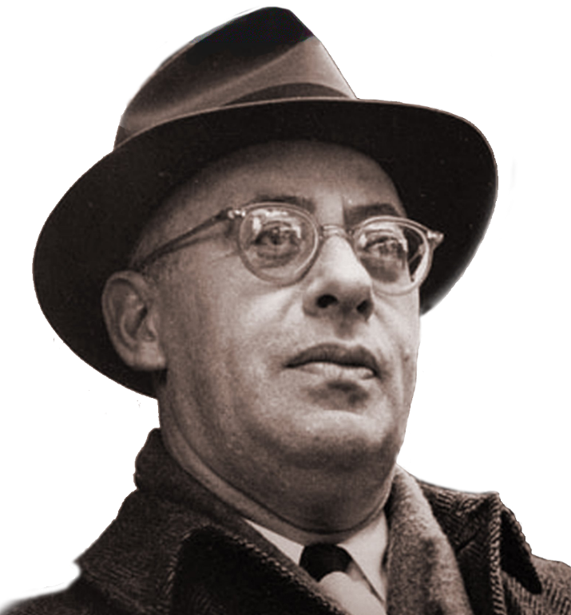
Saul Alinsky
“It is a world not of angels but of angles, where men speak of moral principles but act on power principles; a world where we are always moral and our enemies always immoral.”
Saul Alinsky
Saul Alinsky, the Father of the Modern-Day Progressive Movement
Saul Alinsky was so admired by Hillary Clinton that she wrote her senior thesis on his importance. Barack Obama was also greatly influenced by his writings; in fact, Obama wrote a chapter in a book lauding Alinsky.
As you will see from the quotes on the following pages, the problem is Alinsky’s methods for bringing about social change:

Slide 33
Saul Alinsky
“Never let a crisis go to waste.”
“Control health care and you control the people.”
“The thirteenth rule of radical tactics: Pick the target, freeze it, personalize it, and polarize it.”
“The despair is there; now it’s up to us to go in and rub raw the sores of discontent, galvanize them for radical social change.”
“They have the guns and therefore we are for peace and for reformation through the ballot. When we have the guns then it will be through the bullet.”
“The threat is generally more terrifying than the thing itself.”
“True revolutionaries do not flaunt their radicalism. They cut their hair, put on suits, and infiltrate the system from within.”
“The most unethical of all means is the non-use of any means.”

Slide 34
Saul Alinsky
“The Haves publicly pose as the custodians of responsibility, morality, law, and justice (which are frequently strangers to each other), they can be constantly pushed to live up to their own book of morality and regulations. No organizations, including organized religion, can live up to the letter of their own book. You can club them to death with their “book” of rules and regulations.”
“The establishment can accept being screwed, but not being laughed at.”
“To the man of action the first criterion in determining which means to employ is to assess what means are available. Reviewing and selecting available means is done on a straight utilitarian basis — will it work? Moral questions may enter when one chooses among equally effective alternate means.”
“If the organizer begins with an affirmation of love for people, he promptly turns everyone off. If, on the other hand, he begins with a denunciation of exploiting employers, slum landlords, police shakedowns, gouging merchants, he is inside their experience and they accept him.”
This last quote is exactly how the Nazis convinced the populations of Europe, especially Eastern Europe, that the Jews were the source of all of their problems. This evil is beginning again in Europe and America.

Slide 36
This Presentation Was Created by:
Permission to use is granted with an attribution to:
Brad Fregger, Groundbreaking Press (www.groundbreaking.com)

